Slide 1
Non-Academic Outcomes Research
ALBE Professional Development Sessions
2009-2010

Slide 2


Partners & Funders
Partners
Department of ECE
Aurora College
NWT Literacy Council
Funders
Canadian Council on Learning/ ECE

Slide 3
Objectives
Expand our knowledge of non-academic outcomes
Develop and test a culturally appropriate approach to document these outcomes (to stimulate critical reflection; to give voice to learners’ lived learning experiences, thereby empowering them
Develop a training plan and tool to support the documenting of NAOs in all ALBE programs in the NWT

Slide 4
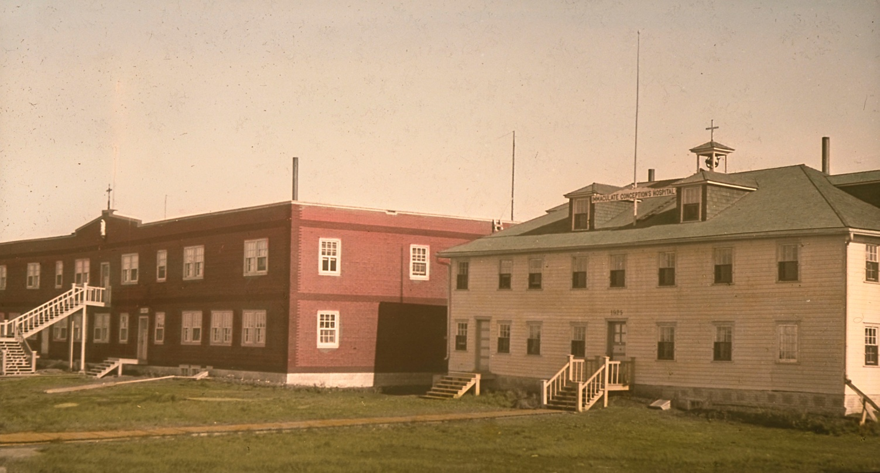
The background
Formal education is still relatively new in the NWT
Legacy of residential schooling
Current levels of educational attainment
Early school leaving
Adult literacy statistics (IALSS)

Slide 5
What others have said
What are non-academic or ‘soft’ outcomes?
Many adult educators believe the picture we paint of learners is incomplete
Soft outcomes are intermediate … lead to hard outcomes
NAOs fit with a holistic worldview
Often ignored – accountability frameworks favour measurable outcomes over hard-to-measure outcomes
We start out by making the important measurable, and end up making the measurable important. (Wiliam, in Westel, 2005)

Slide 6
How we did the research
Three programs: campus-based CLC; medium sized CLC; small CLC
Over two academic years
Recorded the stories of learners’ journeys (narrative)
  Why did you go on the journey?
  Where did you start from?
  What helped you?
  What obstacles were in your way?
  Where did you get to?
  What were your successes?
Transcribed the stories; took them
back to learners to review & verify

Slide 7
Ethnicity
Ethnicity of participants

Slide 8
Age
Age of participants
Notes:
Age

Slide 9
Highest grade level completed
Highest grade level completed

Slide 10
Family status
Family status

Slide 11
Prior educational experiences
45% felt the school system had not served them well
65% regretted leaving school early
Impact of residential schooling on learners and families
Parents/ grandparents did not understand the importance of education and did not provide support
The effects of residential schooling not only affected [our parents] it affected their children – us – in a negative way.

Slide 12
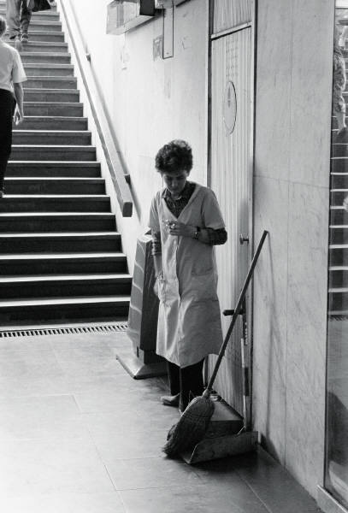
Where learners are going
Personal development: confidence, self-esteem, attitude, identity and potential
To support their children
To get a (good, better) job
To be able to take a post-secondary course

Slide 13

Where learners are going
I want to find a job that I enjoy and get security for the future. I want to make sure that my kids have what they need to get their education, as well as a home and food in the fridge.
This is for my girl. It’s not for anybody else.
I don’t want to clean bathrooms and other rooms.

Slide 14

Changing Goals
Learners goals changed over time as they became more confident
  From upgrading to career-oriented
  From certificate to diploma
  From college to university

Slide 15
Challenges
Fear (negative views of their own abilities), embarrassment & shame
Family responsibilities and disruption
Financial challenges
I admit I was scared shitless. I didn’t think I could do it.
I almost gave up a lot of times because of homesickness.
It’s hard financially, it’s hard mentally, emotionally, it’s too much work, but that’s just how life is.

Slide 16
Negative views
dumb
stupid
looked down on
degraded
failure
You know you always think you’re dumb but you’re not.

Slide 17
Non-academic outcomes
Three important areas that ALBE influences:
  Attitudes
  Skills (personal, practical)
  Behaviours

Slide 18
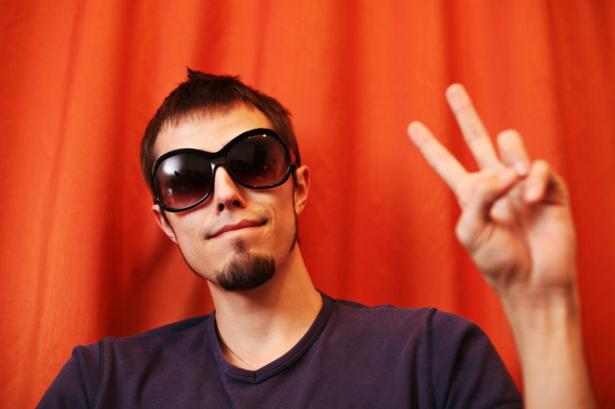
Attitude change
  More positive
  Better attitude towards learning, life and work
  Changed view of the role of women
.
Coming back to school makes me feel more positive. I don’t feel the same as I did last year. I don’t even look at the world the same as I did last year, totally different.

Slide 19
Skill building
Improved academic skills
Improved personal skills
New practical skills for everyday life
Relationship building skills
Improved readiness for further education & employment

Slide 20
Improved academic skills
Reading and writing
Math
Computers
Science
Social Studies

Slide 21
Improved personal skills
Increased self-confidence & self-esteem
  Less shy; more able to speak out; a ‘new’ voice
  Able to present themselves better
  More independent
  Able to handle challenges better (e.g. personal problems)
  More of a risk taker
  More relaxed
  More open
  More able to stand up for themselves
  More able to go out
  A stronger, better, happier person
Before I wouldn’t say anything because I thought that was for other people, but now I’m finding myself.
I wouldn’t have been able to do that if I hadn’t been part of this program.

Slide 22
Improved personal skills
  Commitment
    Afraid they would not be able to maintain commitment
    A sense of accomplishment (for some the greatest accomplishment)
    Several learners had never stayed committed to anything before
    Support each other to remain committed
.
… stick to the course, come to school, don’t miss. It’s like nobody gets left behind.

Slide 23
New practical skills for everyday life
  Described their skills in terms of things they could now do
    Read to their children
    Help their children with homework
    Help children become more confident
    Spend more time playing with children
    Volunteer in the community
    More organized
    Became a role model for others
.
I wouldn’t have read to her before. I wouldn’t have known any of those words in those books, but now I’ve got books and I read to her and she likes it.

Slide 24
Relationship skills
  Better communication skills
  Family relationships improved
  Families were proud of them
  Attitudes of people in the community improved towards them
  Strong relationships among learners
.
They’re happy for me. They think I’m actually going somewhere. I can see the change. I can feel it in the air. The atmosphere is so different. They look at you and say, “Wow! This is my kid. Look at where she is now.”

Slide 25
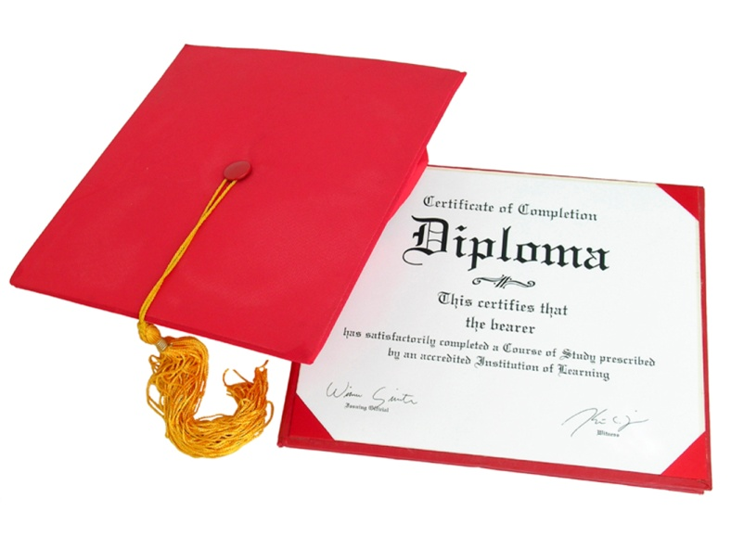
Further education & employment
  Not so embarrassed
  Able to fill out forms and answer questions
  Able to work with others
  More of a team player
  More experience
I wouldn’t have picked the path I’m on if I hadn’t attended the learning centre.

Slide 26
Instructors’ perspectives
  Very similar
  Instructors emphasized:
    The challenges learners faced
    The role learners play in looking after families
    The legacy of residential schools
    How much learners progressed
    Learners’ achievements in self-confidence
    Learners increased involvement in the community
    The commitment of learners

Slide 27
What we learned
  Non-academic outcomes are an important aspect of ALBE
  Learners gained new hope
  ALBE plays a key role in the transformation to hope
  Gains in NAOs support academic learning; gains in academic learning support NAOs
  Reflecting on learning is empowering
  PLAR
I thought I was reading about someone else, and then I realized it was me. ME! I’m so excited.

Slide 28
A framework for the future
  List of types of outcomes & possible indicators
  Where do we go from here?
    A framework
    A tool

Slide 29
The final word
[ALBE] could change their lives…. There might be seven people that quit that really don’t do anything with it. But even if there is one person that did something with it, it’s worth it. If you inspire somebody to do something with their life, that’s worth it …. You can’t save everybody.

